Slide 1
Python Libraries for Data Science

Slide 2
Many popular Python toolboxes/libraries:
• NumPy
• SciPy
• Pandas
• SciKit-Learn
Visualization libraries
• matplotlib
• Seaborn

Slide 3
NumPy
Python Libraries for Data Science
NumPy:
introduces objects for multidimensional arrays and matrices, as well as
functions that allow to easily perform advanced mathematical and statistical
operations on those objects
provides vectorization of mathematical operations on arrays and matrices
which significantly improves the performance
many other python libraries are built on NumPy

Slide 4
Python Libraries for Data Science continuation…
SciPy: collection of algorithms for linear algebra, differential equations, numerical integration, optimization, statistics and more part of SciPy Stack built on NumPy
Pandas:
adds data structures and tools designed to work with table-like data (similar to Series and Data Frames in R) provides tools for data manipulation: reshaping, merging, sorting, slicing, aggregation etc. allows handling missing data
SciKit-Learn: provides machine learning algorithms: classification, regression, clustering, model validation etc. built on NumPy, SciPy and matplotlib.

Slide 5
matplotlib: python 2D plotting library which produces publication quality figures in a variety of hardcopy formats a set of functionalities similar to those of MATLAB line plots, scatter plots, barcharts, histograms, pie charts etc. relatively low-level; some effort needed to create advanced visualization
Seaborn: based on matplotlib provides high level interface for drawing attractive statistical graphics Similar (in style) to the popular ggplot2 library in R

Slide 6
Loading Python Libraries
import Python Libraries
import numpy as np
import scipy as sp
import pandas as pd
import matplotlib as mpl
import seaborn as sns

Slide 7
Reading data using pandas
#Read csv file
df = pd.read_csv(" C:\\Users\\admin\\Downloads\\Salaries.csv") //in ftp
There is a number of pandas commands to read other data formats:
pd.read_excel('myfile.xlsx',sheet_name='Sheet1', index_col=None, na_values=['NA'])
pd.read_stata('myfile.dta') // STATA dta-files, including NA's, value and variable labels
pd.read_sas('myfile.sas7bdat') //statistical files
pd.read_hdf('myfile.h5','df') //hdfs files

Slide 8
Exploring data frames
#List first 5 records
df.head()

Slide 9
EXERCISE
Try to read the first 10, 20, 50 records;
Can you guess how to view the last few records;

Slide 10
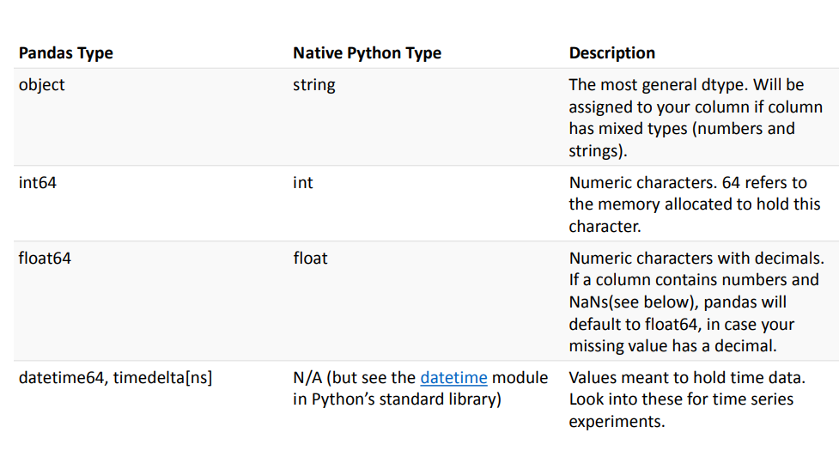
Data Frame data types

Slide 11
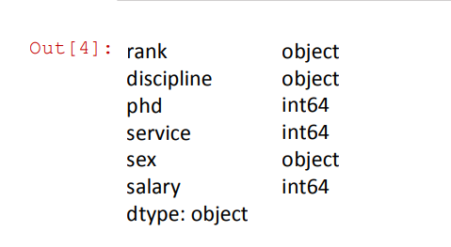
#Check a particular column type
df['salary'].dtype
Out[4]: dtype('int64')
#Check types for all the columns
df.dtypes

Slide 12
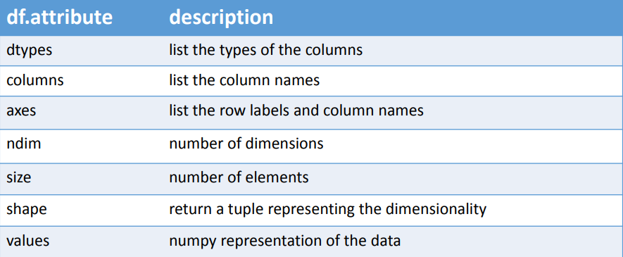
Data Frames attributes

Slide 13
EXERCISE
Find how many records this data frame has;
How many elements are there?
What are the column names?
What types of columns we have in this data frame?

Slide 14
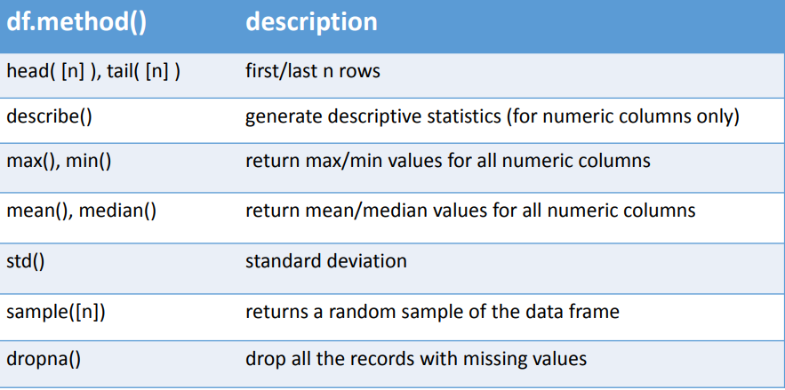
Data Frames methods
Unlike attributes, python methods have parenthesis. All attributes and methods can be listed with a dir() function: dir(df)

Slide 15
EXERCISE
Give the summary for the numeric columns in the dataset
Calculate standard deviation for all numeric columns;
What are the mean values of the first 50 records in the dataset? Hint: use head() method to subset the first 50 records and then calculate the mean

Slide 16
Selecting a column in a Data Frame
Method 1: Subset the data frame using column name:
df['sex']
Method 2: Use the column name as an attribute:
df.sex
Note: there is an attribute rank for pandas data frames, so to select a column with a name "rank" we should use method 1.

Slide 17
EXERCISE
Calculate the basic statistics for the salary column;
Find how many values in the salary column (use count method);
Calculate the average salary;

Slide 18
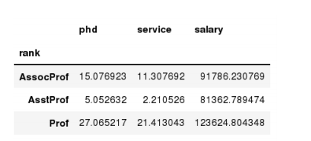
Data Frames groupby method
Using "group by" method we can:
• Split the data into groups based on some criteria
• Calculate statistics (or apply a function) to each group
• Similar to dplyr() function in R
In [ ]: #Group data using rank
df_rank = df.groupby(['rank'])
In [ ]: #Calculate mean value for each numeric column per each group
df_rank.mean()

Slide 19
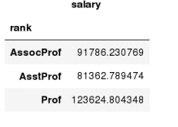
Data Frames groupby method
Once groupby object is create we can calculate various statistics for each group:
In [ ]: #Calculate mean salary for each professor rank:
df.groupby('rank')[['salary']].mean()
Note: If single brackets are used to
specify the column (e.g. salary), then
the output is Pandas Series object. When double brackets are used the output is a Data Frame

Slide 20
Data Frames groupby method
groupby performance notes:
- no grouping/splitting occurs until it's needed. Creating the groupby object
only verifies that you have passed a valid mapping
- by default the group keys are sorted during the groupby operation. You may
want to pass sort=False for potential speedup:
In [ ]: #Calculate mean salary for each professor rank:
df.groupby(['rank'], sort=False)[['salary']].mean()

Slide 21
Data Frame: filtering
To subset the data we can apply Boolean indexing. This indexing is commonly
known as a filter. For example if we want to subset the rows in which the salary
value is greater than Rs 120K:
In [ ]: #Calculate mean salary for each professor rank:
df_sub = df[ df['salary'] > 120000 ]
Print (df_sub)
Any Boolean operator can be used to subset the data:
> greater; >= greater or equal;
< less; <= less or equal;
== equal; != not equal;
In [ ]: #Select only those rows that contain female professors:
df_f = df[ df['sex'] == 'Female' ]

Slide 22
In [ ]: #Select only those rows that contain female professors:
df_f = df[ df['sex'] == 'Female' ]

Slide 23
Data Frames: Slicing
There are a number of ways to subset the Data Frame:
• one or more columns
• one or more rows
• a subset of rows and columns
Rows and columns can be selected by their position or label

Slide 24
Data Frames: Slicing
When selecting one column, it is possible to use single set of brackets, but the
resulting object will be a Series (not a DataFrame):
In [ ]: #Select column salary:
df['salary']
When we need to select more than one column and/or make the output to be a
DataFrame, we should use double brackets:
In [ ]: #Select column salary:
df[['rank','salary']]

Slide 25
Data Frames: Selecting rows
If we need to select a range of rows, we can specify the range using ":"
In [ ]: #Select rows by their position:
df[10:20]
Display only selected rows
df[['rank','salary']]
Notice that the first row has a position 0, and the last value in the range is omitted:
So for 0:10 range the first 10 rows are returned with the positions starting with 0
and ending with 9

Slide 26
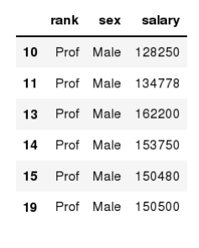
Data Frames: method loc
If we need to select a range of rows, using their labels we can use method loc:
In [ ]: #Select rows by their labels:
df_sub.loc[10:20,['rank','sex','salary']]

Slide 27
Data Frames: method iloc
If we need to select a range of rows and/or columns, using their positions we can
use method iloc:
In [ ]: #Select rows by their labels:
df_sub.iloc[10:20,[0, 3, 4, 5]]

Slide 28
df.iloc[0] # First row of a data frame
df.iloc[i] #(i+1)th row
df.iloc[-1] # Last row
df.iloc[:, 0] # First column
df.iloc[:, -1] # Last column
df.iloc[0:7] #First 7 rows
df.iloc[:, 0:2] #First 2 columns
df.iloc[1:3, 0:2] #Second through third rows and first 2 columns
df.iloc[[0,5], [1,3]] #1st and 6th rows and 2nd and 4th columns

Slide 29
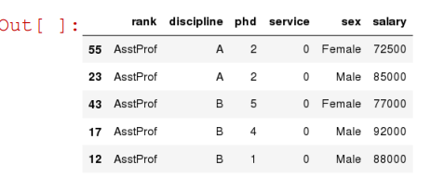
Data Frames: Sorting
We can sort the data by a value in the column. By default the sorting will occur in
ascending order and a new data frame is return.
In [ ]: # Create a new data frame from the original sorted by the column Salary
df_sorted = df.sort_values( by ='service')
df_sorted.head()

Slide 30
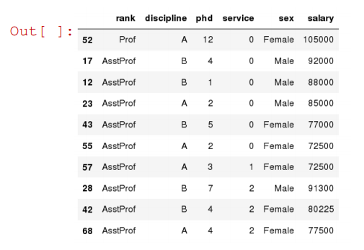
SORTING CONTINUATION…
We can sort the data using 2 or more columns:
In [ ]: df_sorted = df.sort_values( by =['service', 'salary'], ascending = [True, False])
df_sorted.head(10)

Slide 31
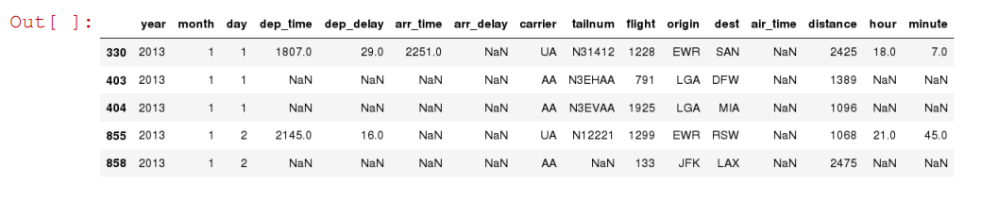
Missing Values
Missing values are marked as NaN
In [ ]: # Read a dataset with missing values
flights = pd.read_csv("flights.csv") //in ftp
In [ ]: # Select the rows that have at least one missing value
flights[flights.isnull().any(axis=1)].head()

Slide 32
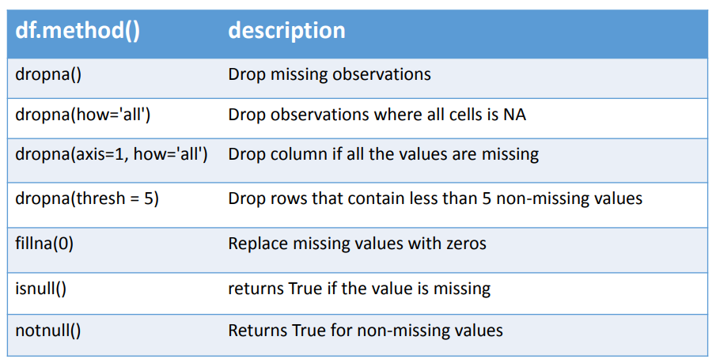
There are a number of methods to deal with missing values in the data frame:

Slide 33
Missing Values
When summing the data, missing values will be treated as zero
• If all values are missing, the sum will be equal to NaN
• cumsum() and cumprod() methods ignore missing values but preserve them in
the resulting arrays
• Missing values in GroupBy method are excluded (just like in R)
• Many descriptive statistics methods have skipna option to control if missing
data should be excluded . This value is set to True by default (unlike R)

Slide 34
Aggregation Functions in Pandas
Aggregation - computing a summary statistic about each group, i.e.
compute group sums or means
compute group sizes/counts
Common aggregation functions:
min, max
count, sum, prod
mean, median, mode, mad
std, var

Slide 35
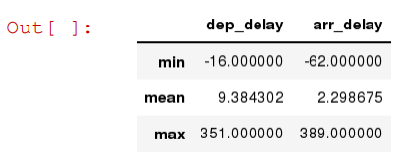
Aggregation Functions in Pandas
agg() method are useful when multiple statistics are computed per column:
In [ ]: flights[['dep_delay',
'arr_delay']].agg(['min','mean','max'])

Slide 36
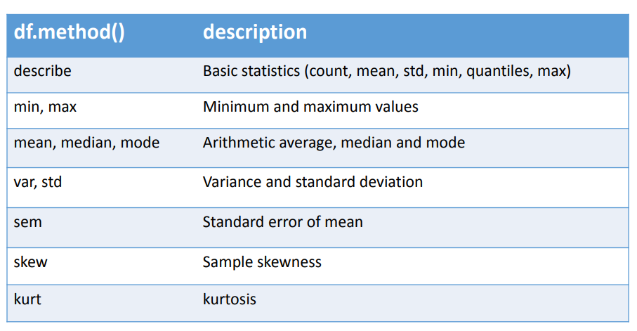
Basic Descriptive Statistics

Slide 37
Graphics to explore the data
Seaborn package is built on matplotlib but provides high level interface for drawing attractive statistical graphics, similar to ggplot2 library in R. It specifically targets statistical data visualization
To show graphs within Python notebook include inline directive:
In [ ]: %matplotlib inline

Slide 38
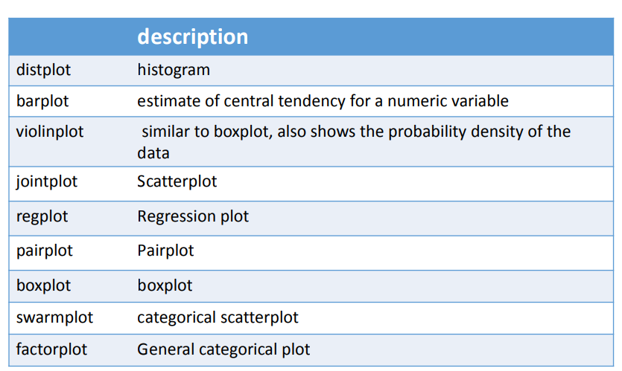
Graphics

Slide 39
Basic statistical Analysis
statsmodel and scikit-learn - both have a number of function for statistical analysis
The first one is mostly used for regular analysis using R style formulas, while scikit-learn is
more tailored for Machine Learning.
statsmodels:
• linear regressions
• ANOVA tests
• hypothesis testings
• many more ...
scikit-learn:
• kmeans
• support vector machines
• random forests
• many more ...

